Slide 1
Pt. 5: Chirality and Liquid Crystallinity Lecture #15
Chirality
Optical acitvity
Hand- picked tartaric acid
Chirality - asymmetric carbon
Enantiomer resolution
Lock and Key; Hand in glove
Chirality and Pharmaceuticals
Chirality and Astrophysics - seriously

Slide 2
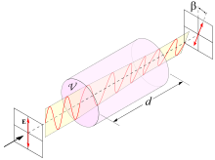
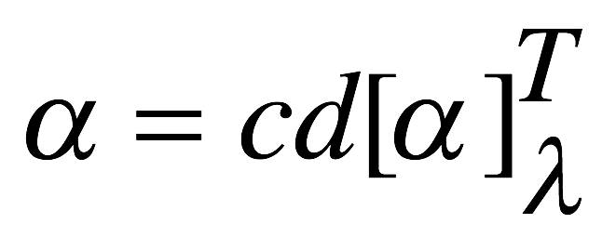

Optical activity
Solutions of some (but not all) organic molecules
rotate the plane of polarisation of passing light.
Some clockwise (‘dextrorotary’): e.g. sucrose, camphor
Some anticlockwise (‘levorotary’): e.g. cholesterol
Others not at all
Examples
Compound name [α]_{D}²⁰[deg dm⁻¹cm³ g⁻¹]
(+)-Cavicularin +168.2°^{[9]}
Camphor +44.26°^{[5]}
Cholesterol −31.5°^{[5]}
D-Fructose −92°^{[5]}
D-Glucose +52.7°^{[5]}
D-Lactose +52.3°^{[5]}
Penicillin V +223°^{[7]}
Progesterone +172°^{[8]}
D-Sucrose +66.37°^{[5]}
Taxol A −49°^{[6]}
Testosterone +109°^{[8]}
Quantitative:
α: angle of rotation (in degrees)
d: Path length (typically in dm)
c: Concentration (in g/mL)
[α]: Specific rotation, a molecular property
at a particular Temperature, and wavelength
(usually, 20 ºC and 589 nm (Na D line) P15.1
It’s not (conventional) birefringence (solution!)
‘circular birefringence’ is a formal description, but not an explanation

Slide 3
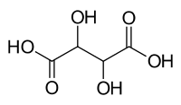
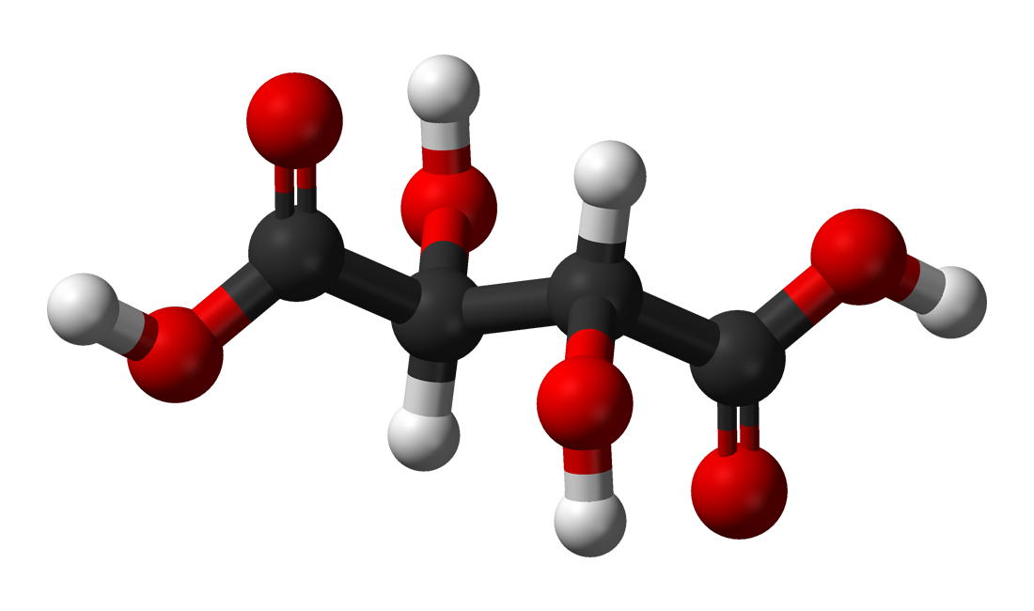
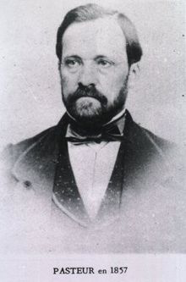
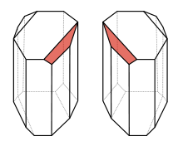
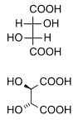
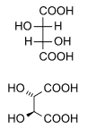
Tartaric acid
Natural tartaric acid (e.g. from wine):
Optically active, + 12.4 ºdm⁻¹cm³g⁻¹
Synthetic tartaric acid: Not optically active
?
Synthetic NaK tartrate Xtals
Xtallised from solun.
Display 2 habitats
→ ‘hand picking’ under μscope
Hand picked fractions:
Optically active!
Same / opposite
to natural tartaric acid
‘Molecular asymmetry’
Louis Pasteur 1848
levotartaric acid dextrotartaric acid
(L-(+)-tartaric acid) (D-(-)-tartaric acid
L/D molecules are mirror images of each other
Synthetic Tartaric acid: Racemic / racemat
1 : 1 mix of L / D, activities cancel
But natural synthesis delivers pure ‘enantiomer’
‘Fischer
projection’

Slide 4
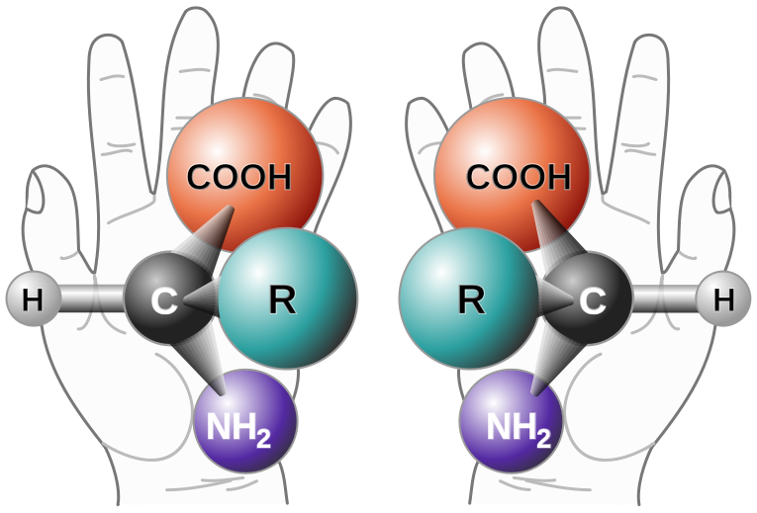
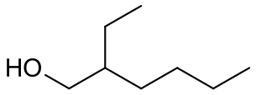
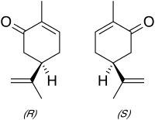
Chirality Greek χειρ = ‘hand’
Molecule ≠ its mirror- image (like your hands)
Requires atom with at least 4 unequal ‘Ligands’
i.e. 4 chemical bonds: sp³ C ←→ Organic molecules
‘Asymmetric carbon’, ‘chiral centre’ *
(Exceptions: e.g. chiral amines, 3 bonds + ‘lone pair’)
Molecules can have more than one *
Carvone P15.2
*
R carvone:
Spearmint smell
S carvone:
Caraway smell
2-Ethylhexanol
The two enantiomers of a molecule have the same Hamiltonian P15.3
But they interact differently with the ‘receptors’ (odorant binding proteins) in your nose
Hamiltonian / QM = Physics’ sharpest tool cuts no ice with chirality
Notes:
Thalidomide is a teratogen - birth defect inducing. There are two enantiomers; shown is the teratogenic S thalidomide. However, these can interconvert in vivo so you cannot take a pure R-thalidomide and not be at risk of birth defects. Thalidomide was taken for morning sickness. Frances Oldham Kelsey refused permission for thalidomide in the US and only 17 children were affected there. S – sinister (left), R – rectus (right).

Slide 5
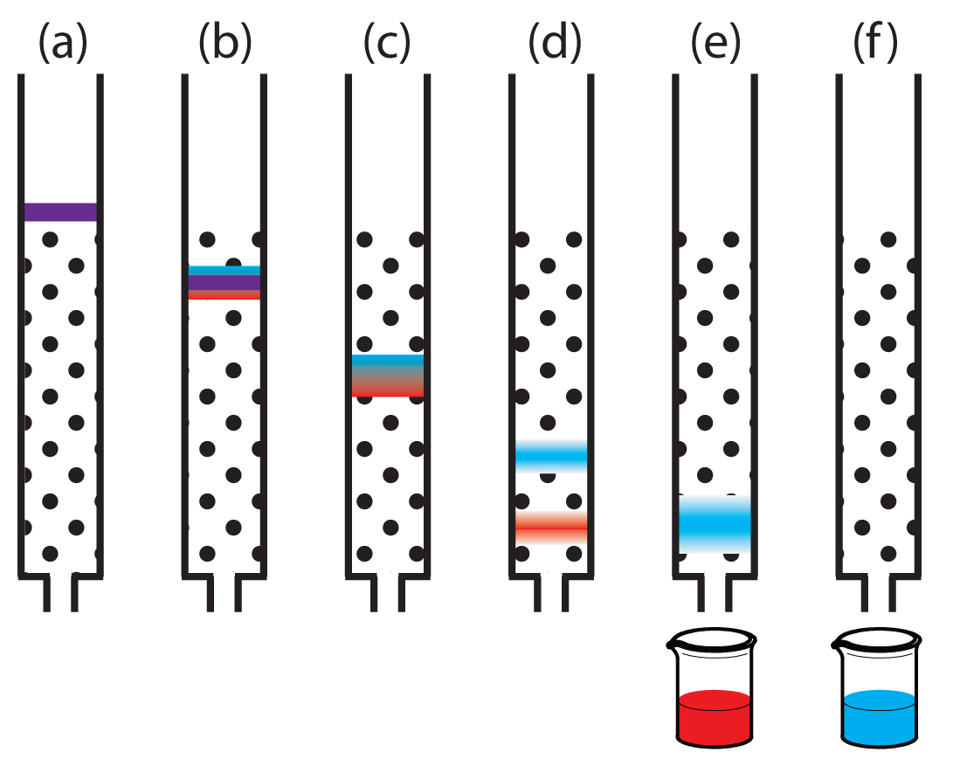
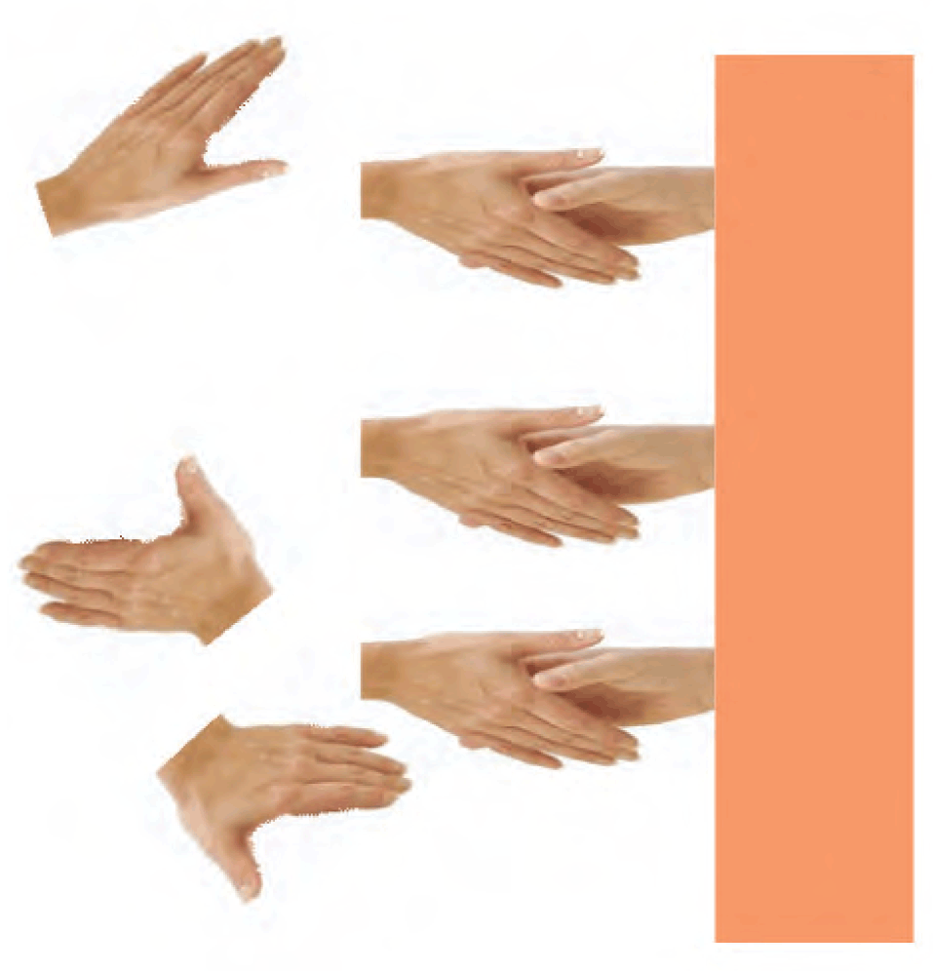
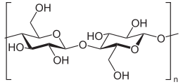
Enantiomer resolution Not all racemic mixtures separate on Xtallisation
Chiral column chromatography
L/R enatiomer show different
adhesion to stationary phase
One trickles through faster
(colours for illustration only)
Dissolved
racemat
Stationary
Phase
But: Needs pure enantiomer in stationary phase,
typically a biopolymer (cellulose, cyclodextrin)
You need to put chirality into the column to get enantiomer resolution
Yet sucrose (aka ‘sugar’) from sugar beet is a pure enantiomer without later separation

Slide 6
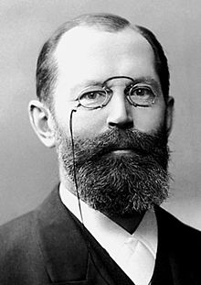
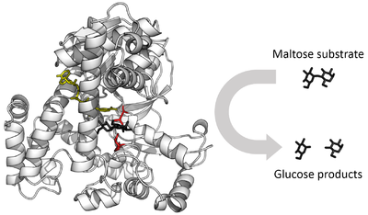
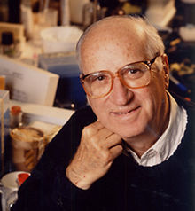
‘Lock and key’ model
Enzymes = biocatalysts: Highly specific catalysis of biochemical reactions
e.g. Glucosidase converts the ‘substrate’ maltose into the product glucose
And nothing else…
Emil Fischer
Nobel Prize 1902
‘Glucosidase’
Enzymes = Proteins of clearly defined shape.
Fischer 1894: The shape of Substrate and Enzyme must fit together ‘like lock and key’
Modified by Koshland 1958: ‘Induced fit’ model to account for the soft character of enzymes
‘Hand and glove’
The right hand won’t fit the left glove…
Biochemical interactions are chirally selective

Slide 7
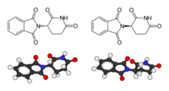
Chirality and Pharmaceuticals Chirality may be essential for effectiveness of medicines Or cause sinister side effects…
An infamous chiral molecule
2-(2,6-dioxopiperidin-3-yl)-2,3-dihydro-1H-isoindole-1,3-dione
‘Thalidomide’
Medication against nausea, including ‘morning sickness’
Probably, one enantiomer acts against sickness
But the other causes defects in embryos (underdeveloped limbs and organs)
Thalidomide racemices in vivo
1958 – 1961: ≈ 2000 children did not survive infancy,
≈ 10,000 disabled children (mostly Germany, UK)

Slide 8
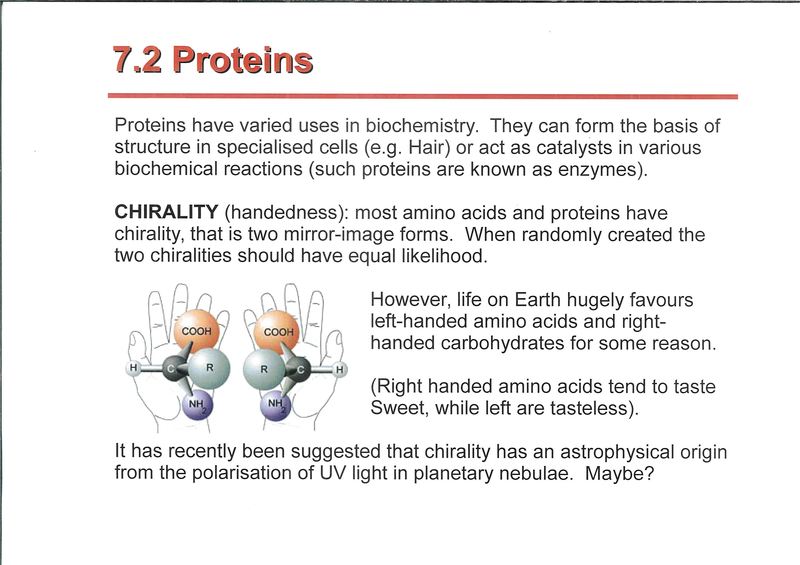
Does chirality come from Space ? A nicked slide…
…with permission, Prof S Goodwin, PHY229 ‘Extrasolar Planets and Astrobiology’

Slide 9
Summary: Lecture #15 Chirality
Optical activity: Rotating the plane of polarisation
Displayed by some organic molecules in solution
Often found for org. molecules extracted from nature, but not their synthetic equivalents
‘Molecular asymmetry’ sometimes expressed in Xtal habit
Molecular asymmetry = molecule different from its mirror image, (‘enantiomers’), known as chirality
Chiral centre = Asymmetric carbon
‘Racemic’ enantiomers tricky to separate (e.g. chiral chromatography)
Chirality ←→’Lock and key’ / ‘Hand in glove’ fit
Chirality essential in Pharmaceutical science
Where it all comes from originally… is still ‘out there’
The material contained within this lecture can not be found in SCM.

Slide 10
Lecture #16 Liquid Crystals I: Phenomena
What are liquid crystals?
The thermotropic ‘families’
A few examples of LC phases
LC Displays:Twisted waveguides, Frederiks transition

Slide 11
Liquid crystals (LCs)
Polymer and ‘small’ molecule LCs (we focus on ‘small’)
Thermodynamic equilibrium phases btwn solid / (isotropic) liquid: ‘Mesophases’
Some are thermotropic, some lyotropic (usually polymer LCs)
Orientational, but no or low positional order: Anisotropy
Based on anisotropic (and ‘stiff’) molecules
‘Mesogens’, classification into ‘families’ by shape
LCs cannot withstand shear, and have no unit cell
→ They are liquids, not crystals

Slide 12
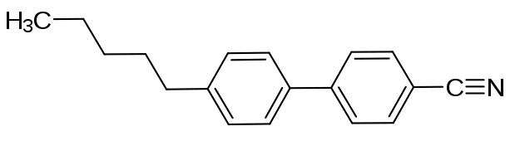
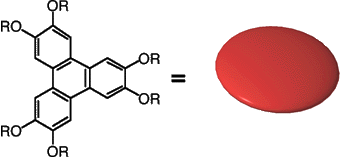
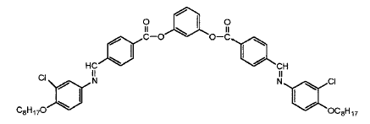
(Thermotropic) mesogen ‘families’
Classed according to molecular shape
‘Calamitic’ (rod- shaped) : positive uniaxial Δn
‘Sanidic’ (board- shaped) : biaxial Δn
‘Discotic’ (disc- shaped) : negative uniaxial Δn
‘Bananas’ (crescent- shaped)
‘5CB’
GW Gray et al.
Hull 1972
Many different phases within each family, often same LC material undergoes a series of
transitions btwn different LC phases
Also thermotropic polymer LC families, and lyotropic LCs
The LC ‘zoo’ rivals particle physics for diversity of species

Slide 13
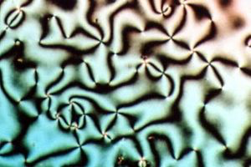
Calamitic phases: Nematics and smectics
Nematic liquid crystals
No positional order, only directional → birefringence
(uniaxial, positive)
Smectic liquid crystals
Directional and positional (in one dimension) order
also birefringent
Nematic ‘Schlieren’ texture
in Polmiscope
Birefringence, domains, defects

Slide 14
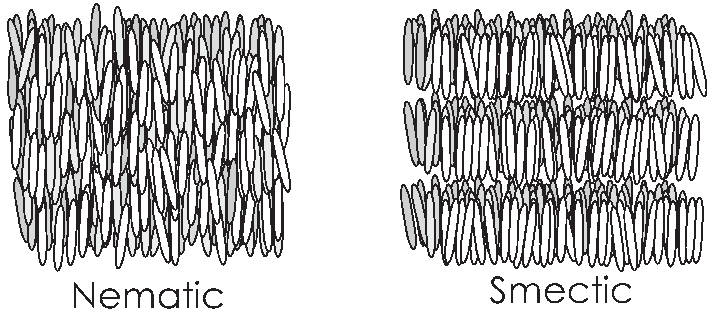
Calamitic phases: Nematics and smectics
Director n
Nematic: Preferred but non- perfect
alignment along director n.
No crystal lattice / unit cell
Note symmetry: n ‘=’ – n
Smectic A structure.
Alignment + layering: Some periodicity
Smectic C has an off-axis director
P16.1

Slide 15
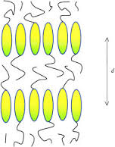
‘Molecular engineering’ To control phase behaviour
Smectic A phase : ‘Microphase separation’
Btwn ‘aromatic’ cores and ‘aliphatic’ tails
‘Aromatic’: Unsaturated rings
‘Aliphatic’: Usually, saturated C chains
Different polarisability ➔ χ > 0
microphase separation requires sufficiently long tails
Even better: Tails at both ends
!Note: The same molecule may have different LC phases
Transitions driven by Temp, e.g.
Crystalline → smectic A → nematic → isotropic,
or more complex sequences

Slide 16
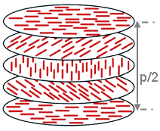
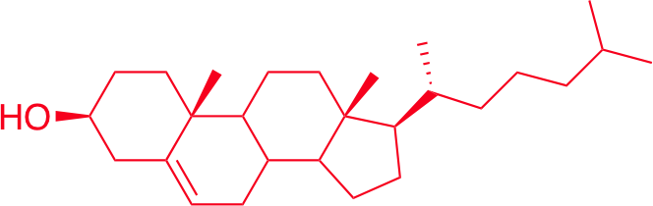
Chiral nematic / ‘cholesteric’ phase
Nematic phase with a “twist”
Based on chiral mesogen, or dopant
Clockwise or anticlockwise twist of
director with ‘pitch’ p >> 1 molecule
Tune p by blending
Most interesting: p ≈ λ_{Light}
‘Bragg stack’ = dielectric mirror for matching
sense of circ. Pol .light
Circular polariser, CP light source
The chiral nematic phase is named ‘cholesteric’ after first observation in cholesterol derivatives
Image from Wikipedia

Slide 17
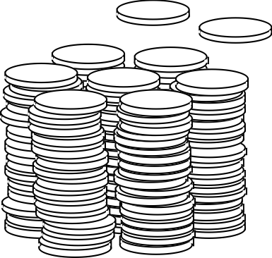
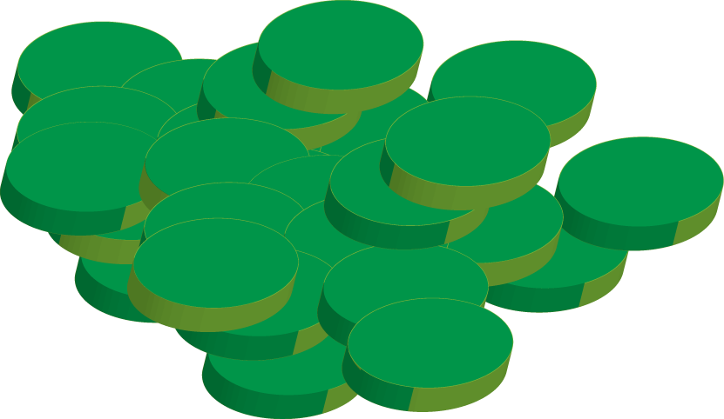
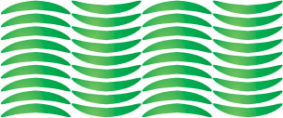
Discotic and banana phases
Hexagonal discotic columnar
phase
(from SCM)
Nematic discotic phase
Negative uniaxial birefringence
A ‘banana’ phase
Note- shown too ordered

Slide 18
The sliding scale of order
Phase | Positional order | Orientational order
Liquid | None | 
Nematic | None | 
Nematic Discotic | None | 
Cholesteric | None | 
Smectic | 1-D | 
Columnar Discotic | 2-D | 
Crystalline | 3-D | 

Slide 19
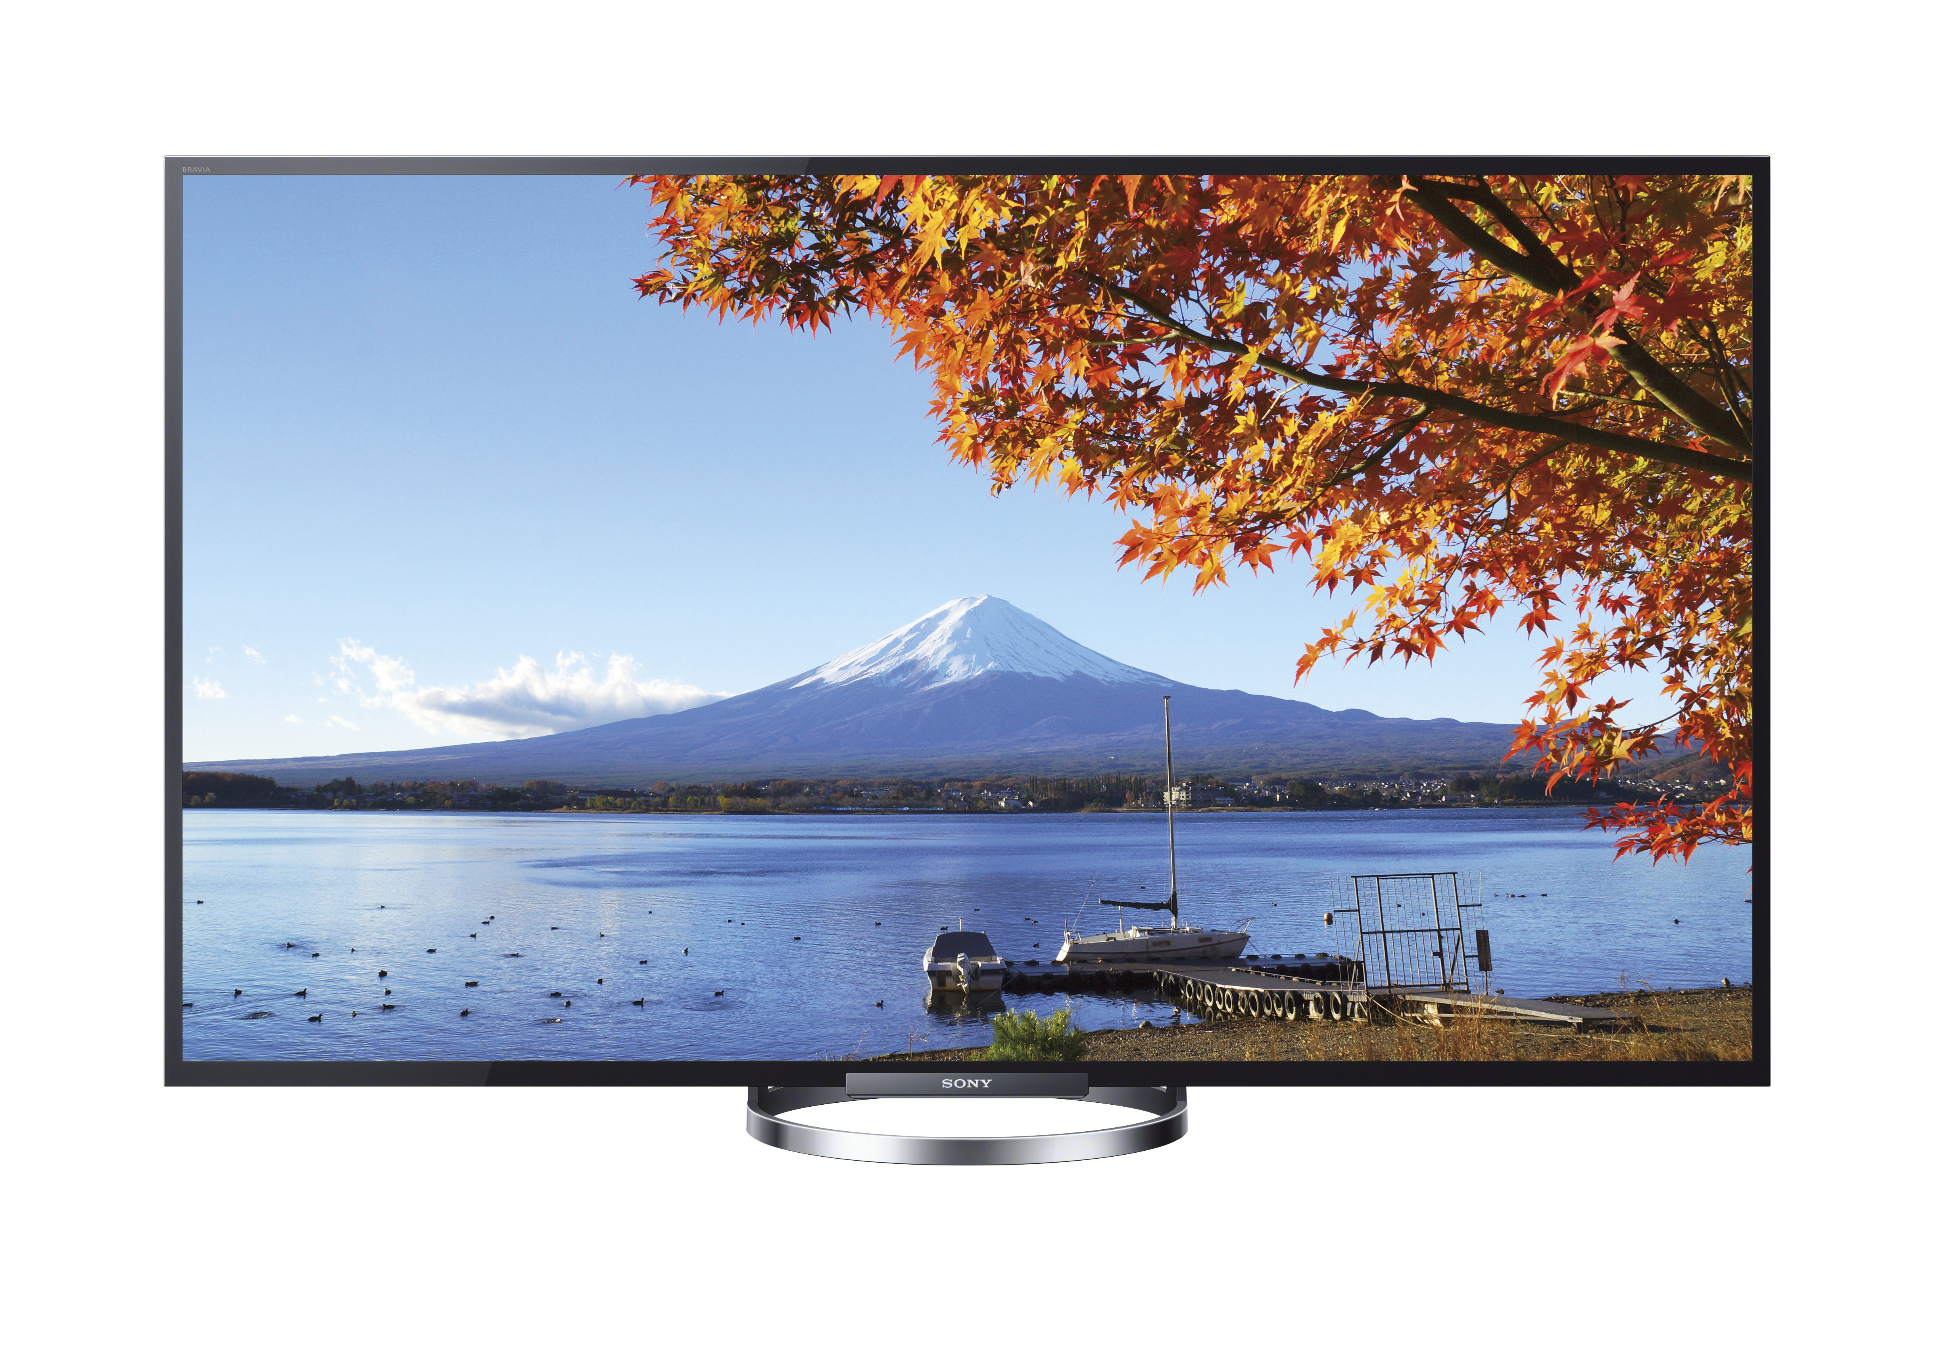
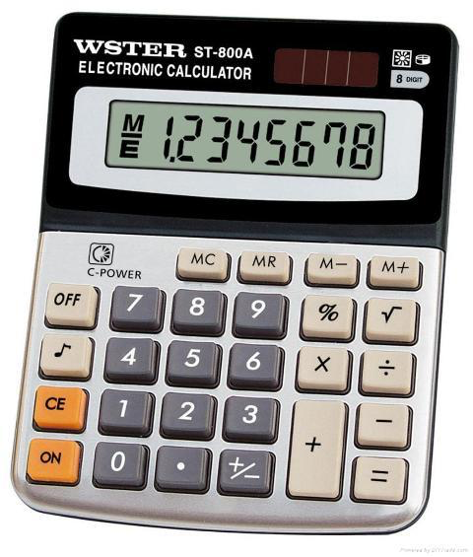
Liquid Crystal Displays: LCDs Then and now
Since 1970s
Now one of the key technologies of the mobile internet
Calculators, laptops, desktops, smartphones, tablets,…
Now, full colour and moving images
Flat panel, low voltage, low power consumption, low weight
‘Passive’: Need external light source

Slide 20
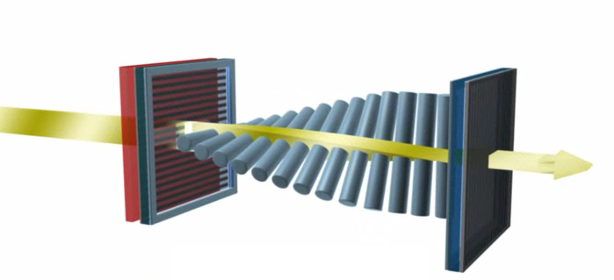
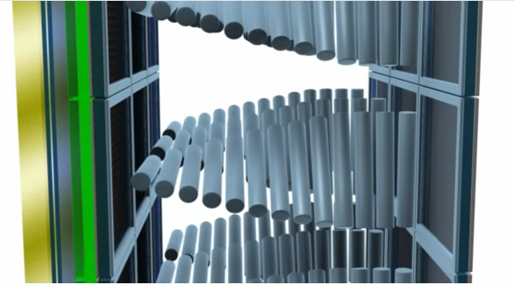
Liquid Crystal Displays (LCDs)
Nematic LC fluid
Twisted nematic display
Birefringent fluid with twisted optical axis
Linear polarisation follows twist
Assuming d >> λ
Glass
(Xed)Polarizers
Transparent Electrodes with
alignment layers
Images from Vikuiti/3M
Notes:
3 subpixels for colour displays with RGB filters. Intensity of light can be controlled to change the colour. Above a critical E-field (Frederiks transition) the nematics flip so that they are pointing perpendicular to plane of the screen. Then the second polarizer blocks out light. The first polarizer is crucial to get rid of stray light. The asymmetry in the twisted nematic is responsible for the low viewing angle. Because the molecules are aligned in a given direction, this alignment changes with different light directions, and this can mean that the display behaves differently at different angles. Birefringent compensation films can be used to improve this matter

Slide 21
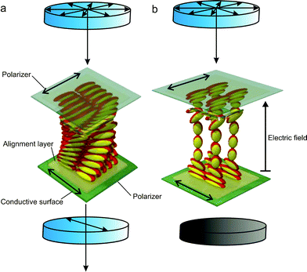
Liquid Crystal Displays
Thermotropic nematic liquid crystals are confined between appropriate glass plates + electrodes + alignment layers
‘Twisted waveguide’ turns polarisation – transmission of backlight (passive display)
Re- align director by voltage / electric field
(Frederiks transition aka ‘switching’)
No more turning of polarisation, no more transmission
Notes:
p-n-pentyl-p’-cyanobiphenyl is usually abbreviated 5CB.

Slide 22
Summary Lecture #16 Liquid Crystals I
* Liquid crystalline phases are liquids with some degree of order
* Thermodynamic equilibrium phases
* Type of ordering controlled by molecular shape
* Different shapes → different LC ‘families’
* ‘Molecular Engineering’ to control shape and phases
* Same molecules may go through several LC phases from within its ‘family’
* Sliding scale of order in between proper crystal, and isotropic liquid
* Liquid crystal displays: Twisted waveguide, Frederiks transition
Some of this material is covered in SCM 7.1, 7.2

Slide 23
Lecture #17 The Maier Saupe lecture
Liquid Crystals II – Theory
The Frederiks transition
Quantifying nematic order: Order parameter
Maier Saupe theory of nematic phase

Slide 24
Frederiks transition
Voltage- driven director re- alignment in LC cell
Essential for LCD technology
Zero V: ‘twisted waveguide’
Director in plane
Turns polarisation, light transmits
V > V_{crit}:
Director aligns // field, orthogonal to plane
No more twist, no change of polarisation
Light blocked

Slide 25
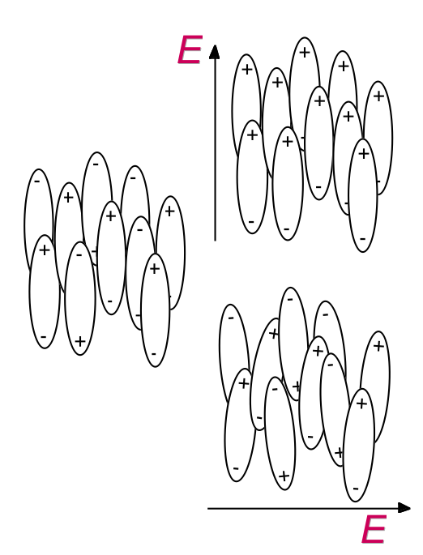
Energetics of F- transition
Elastic energy (F_{el}) increased due to bend, twist, and splay
Director needs to stick flat to interfacial alignment layer, distorted pattern within cell
Electric Energy (F_{field}) reduced by n // E field:
LC Dielectric constant is anisotropic, larger // director
From SCM, induced dipoles
shown wrong on the right side
Lower Higher Energy

Slide 26
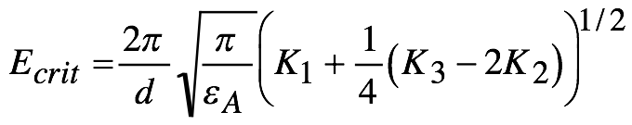
E_{crit}/V_{crit} for F- transition
Zero / low E: F_{tot} = F_{el} + F_{field} minimised by planar director
E exceeds E_{crit}: F_{tot} minimised by out- of- plane director pattern
d cell thickness, ε_{A} = ε₀Δε dielectric anisotropy, K_{1/2/3}: Elastic constants
More succinct: Critical voltage, V_{crit} = E_{crit} d
V_{crit} independent of d
V_{crit} characteristic of a specific nematic LC at given T
P17.1

Slide 27
Nematic ordering
Nematic order (alignment) brings enthalpic gain (both due to better packing, and stronger interactions), but entropic loss.
How do we quantify alignment, and orientational entropy/enthalpy?
Through an orientation function, f(θ)
Director defines θ = 0
f(θ) = f(π - θ) – remember n ‘=‘ - n

Slide 28
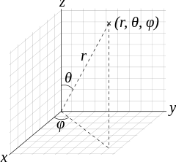
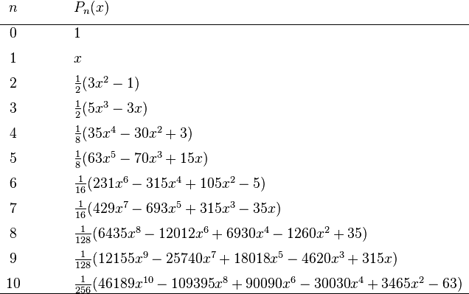
Probability of orientation f(θ)
f(θ)dΩ gives fraction of molecules pointing into solid angle dΩ
Independent of φ (for calamitic phases- not for sanidics)
Nematic: Peaks at θ = 0
Isotropic: f(θ) = 1/4π
Any f(θ) can be expanded into series of
Legendre polynomials, P_{n}(x) = P_{n}(cosθ)
Rmbr ‘spherical harmonics’ Y^{l}_{m} from QM…
Only even P_{n} allowed (non- zero):
n ‘=‘ -n

Slide 29
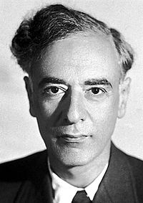
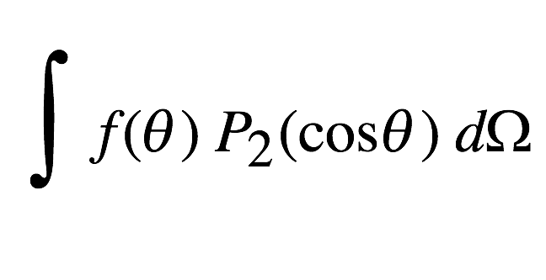
Nematic order parameter
f(θ) is quantified/summarised by the average of P₂ (the lowest non- vanishing, non- isotropic moment)
OP S = = <P₂(cosθ)> = ½ <3cos²θ - 1>
S serves as order parameter for the nematic phase
Isotropic liquid: S = 0 P17.2
Perfect alignment: All molecules aligned parallel to the director, S = 1
Nematic: 1 > S = S(T) > 0, typically 0.5 to 0.9
Linked to birefringence: Δn = SΔn_{max}
Order parameter: General concept introduced by Landau
Every ordered phase / phase transition has its order parameter
Not specifically invented for nematic phase
Lev Landau, Nobel Prize 1962

Slide 30
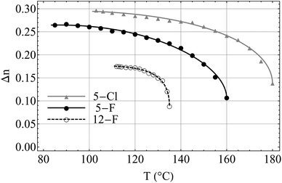
Nematic – isotropic: 1st order PT
OP S = < P₂(cosθ)>
S = 0 in isotropic phase
S ‘jumps’ to S > 0 at T_{ni}
(Maier/Saupe: S = 0.44 at T_{ni})
(Small) latent heat at n → i
S rises as T drops
Typically, S = 0.5 … 0.9
S(T) → 1 for T → 0
(hypothetically- crystallises before)
Easiest seen experimentally in
Δn(T) ~ S(T)
Order parameter
Temperature
N Avci et al., Soft Matter 9, 1066 (2013)
Notes:
The Curie point of a ferromagnetic material is the temperature above which it loses its characteristic ferromagnetic ability. At temperatures below the Curie point the magnetic moments are partially aligned within magnetic domains in ferromagnetic materials. As the temperature is increased from below the Curie point, thermal fluctuations increasingly destroy this alignment, until the net magnetization becomes zero at and above the Curie point. Above the Curie point, the material is purely paramagnetic. At temperatures above the Curie point, an applied magnetic field has a paramagnetic effect on the magnetization, but the combination of paramagnetism with ferromagnetism leads to the magnetization following a hysteresis curve with the applied field strength. The destruction of magnetization at the Curie temperature is a second-order phase transition and a critical point where the magnetic susceptibility [M/H or -1 + B/(µ₀H)] is theoretically infinite.

Slide 31
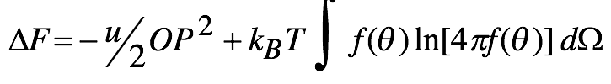
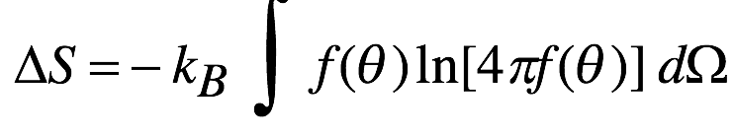
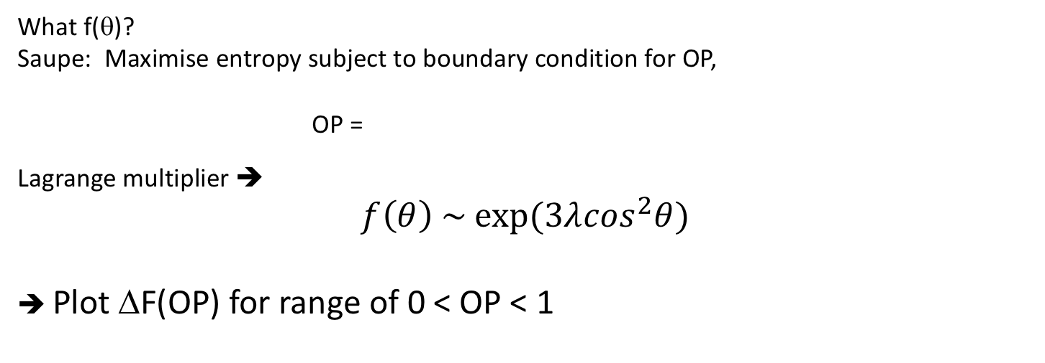
Maier- Saupe mean field theory Here, order parameter S is called OP to distinguish from entropy S
Assume energy (U) gain per molecule from parallel alignment ΔU = -^{u}/₂ OP² (u = ‘coupling parameter’, specific to particular species)
Ignore pΔV (improved packing)
But entropy loss due to alignment,
< 0?
What f(θ)?
Saupe: Maximise entropy subject to boundary condition for OP,
OP =
Lagrange multiplier ➔
$$f\left(θ\right) \sim exp⁡(3λ\cos^{2}θ)$$
➔ Plot ΔF(OP) for range of 0 < OP < 1

Slide 32
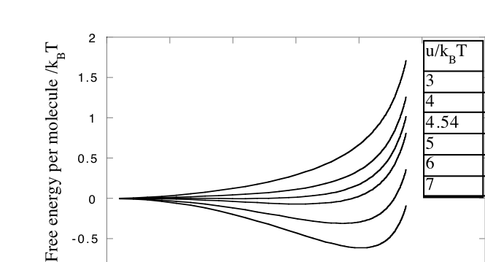
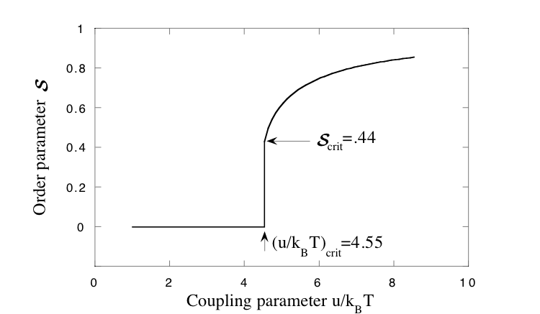
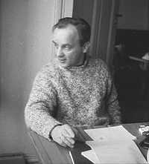
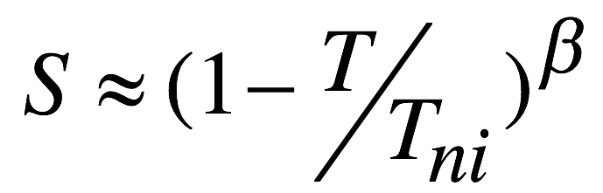
Free energy and order parameter
u/k_{B}T
Predicts first order phase transition at u = 4.55k_{B}T
S = 0.44
Order parameter
From SCM
Maier, W.; Saupe, A.; Z. Naturforsch. A 13 (7): 564–566 (1958)
OP =
P17.3
Alfred Saupe

Slide 33
Merits and limitations
Maier-Saupe theory explains 1st order PT i → n
But:
Not really very good for polymers
Insensitive to fluctuations
This is a very shallow transition so fluctuations are important
Mean-field theories are poor around transitions
Ignores ΔV
Discusses i → n, but ignores i → c
Xtal may ‘undercut’ n before n undercuts i: Then, no n phase
Designing nematic molecules is a balancing act:
Favour // alignment but avoid Xtallisation
- Give molecule some melting entropy without compromising rod shape
- e.g. 5CB: Entropy from tail conformations
T_{CN} = 18 ºC, T_{NI} = 35 ºC
- and … P17.4
Notes:
Temperature independence of C is not necessarily the case if, for example, there are excluded volume interactions that contain a temperature dependence. Small molecule nematic interactions are dominated by van der Waals forces and so temperature independent. Packing considerations, important for larger molecules, are temperature dependent however.

Slide 34
Summary: Lecture #17 Liquid Crystals II - Theory
Frederiks transition: Competition btwn electric and elastic forces, critical voltage.
Nematic-isotropic transition is simplest form of liquid crystalline phase transition
Still reasonably complex
Use an order parameter to quantify liquid crystallinity
Order parameter changes as a function of temperature
Maier- Saupe mean-field theory captures qualitative behaviour of nematic phase
Free energy calculated as function of OP
The material contained within this lecture can be found in SCM chapter 7 section 7.3.
A. M. Donald, A. H. Windle, S. Hanna , Liquid Crystalline Polymers 2nd ed., CUP 2006 (pp 161-163) also covers Maier-Saupe theory

